Slide 1
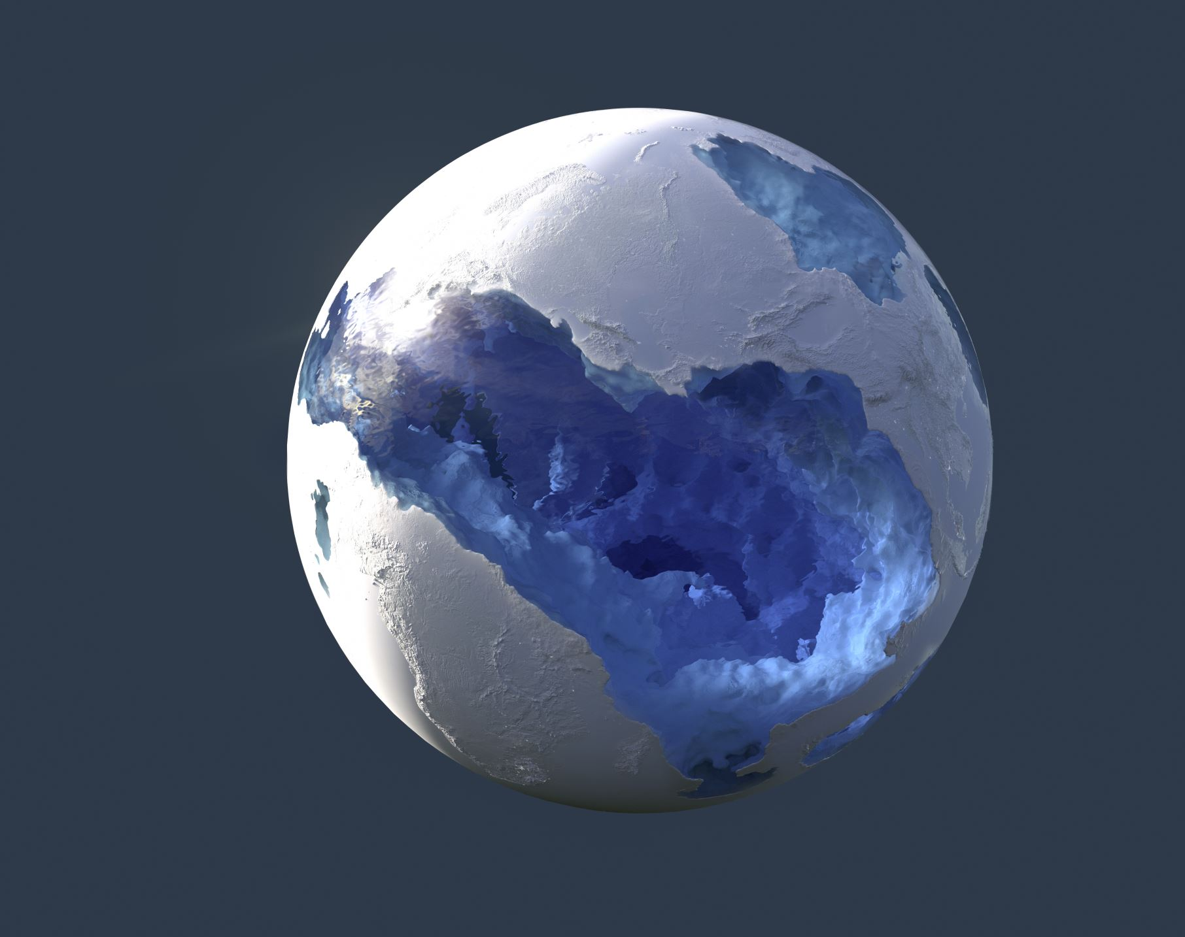
Methane Emissions Throughout the World
By: Jade Supino

Slide 2
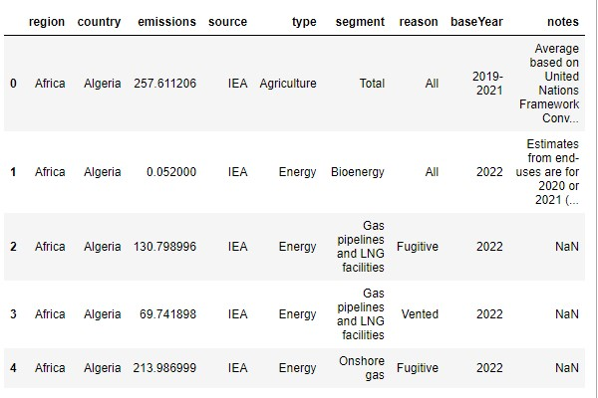
- Compare the World’s methane emission types. - Compare the methane emissions for each region based on the top 2 types of methane emissions. - Compare the top 2 methane emissions for the top 5 methane emitting countries. - Compare the types of methane emissions for the top 5 methane emitting countries. - Compare the two types of energy methane emission for top 5 methane emitting countries. - Compare the agriculture methane emissions for all countries.
Dataset obtained from the World Bank Catalog EnergyData.Info. https://energydata.info/dataset/methane-tracker-database Click on Source in the additional table
https://www.iea.org/data-and-statistics/data-tools/methane-tracker-data-explorer
Dataset contains 1,548 items and 9 attributes.
Objectives
Notes:
IEA = International Energy Agency
Some important objectives to cover include
- comparing the World’s methane emission types
- for the top 2 greatest methane emission types, compare each region and top 5 methane emitting countries
- compare the types of methane emissions for the top 5 methane emitting countries
- compare the two types of energy methane emissions for the top 5 countries
- compare the agriculture methane emissions for all countries

Slide 3
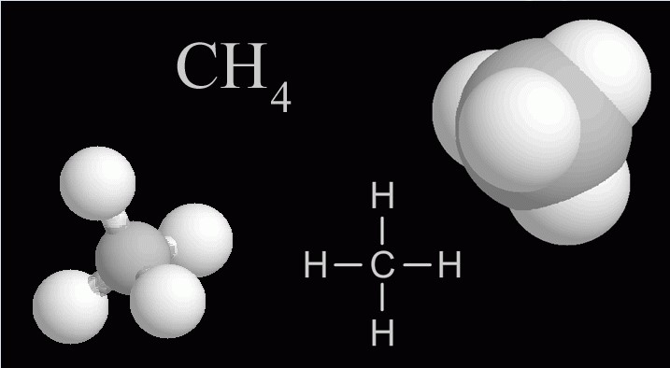
Methane
A powerful greenhouse gas found within our atmosphere (3)
simplest hydrocarbon (made up of carbon and hydrogen
flammable
used as a fuel
principle component of natural gas
comes from human activities (2)
natural gas production
waste decomposition in landfills
digestive processes in livestock/agriculture
Comes from natural sources (2)
wetlands
Greenhouse Gasses are gasses found within our atmosphere that trap heat.(2)
Four main greenhouse gasses that make up Earth's atmosphere are:
water vapour (H2O)
carbon dixoide (CO2)
highest in the atmosphere
methane (CH4)
nitrous oxide (N2O)
All these gasses are important in the affects of the temperature of Earth and the climate.
Representation of Methane (3)

Slide 4
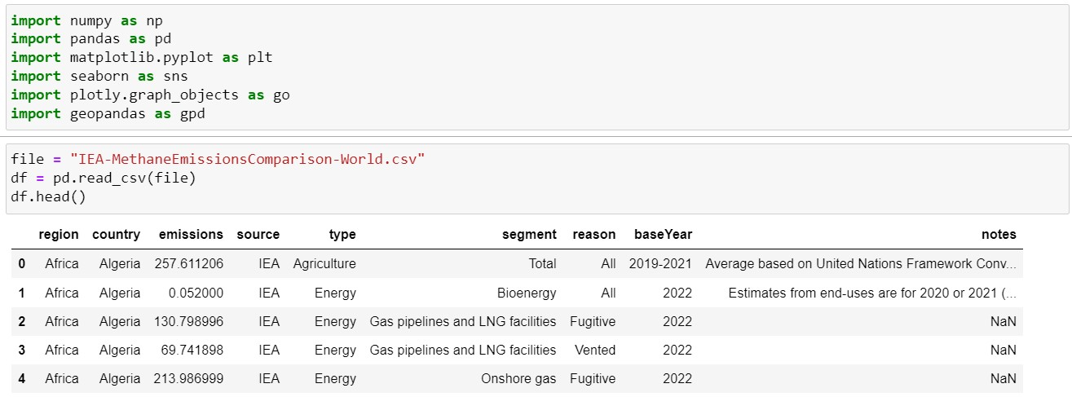
Data Loading
Import necessary libraries
Load the CSV file & convert to a pandas DataFrame
Read/load the CSV file, converting it to a DataFrame

Slide 5
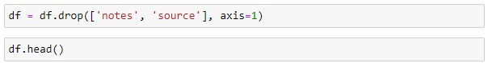
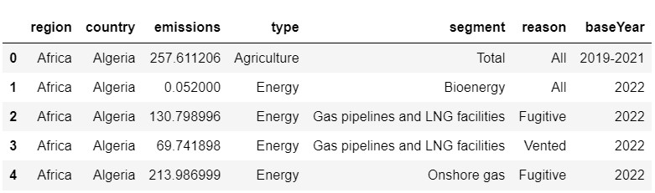
Data Cleaning
Drop notes and source from DataFrame
Notes:
Drop notes and source from dataframe because they are not important in this analysis. Not all the data has notes and the source is all the same, IEA.

Slide 6
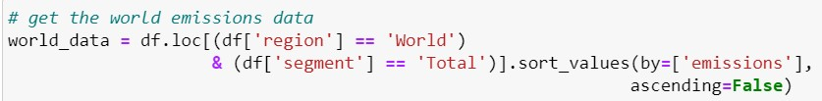
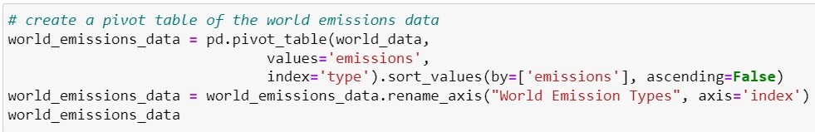
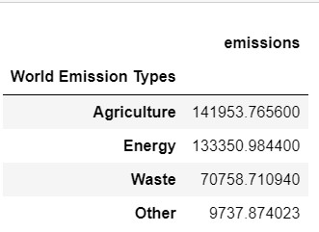
Methane Emission Types Throughout the World
Questions to Answer:
What are the major sources of methane emissions produced worldwide?
What type of emission is most produced throughout the World?
Notes:
Methane Emission Types Throughout the World
Compare the types of Methane emissions throughout the World.
Questions to answer:
What are the major sources of methane emissions produced worldwide?
What type of emission is most produced throughout the World?
Selected the World’s methane emissions data
Used .loc to select the rows in the region column that includes World and segment column that includes Total.
Used the & operator because both conditions must be true
Sorted the values by the emissions columns in descending order
Created a pivot table by setting the index to type of emission and the values to the total emissions for each type. Sorted them in descending order
Renamed the index to World Emission Types to ensure that we know this is the world data

Slide 7
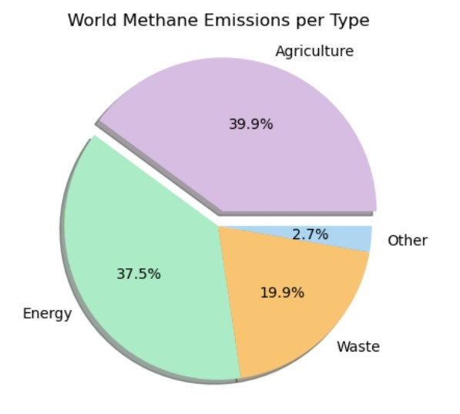
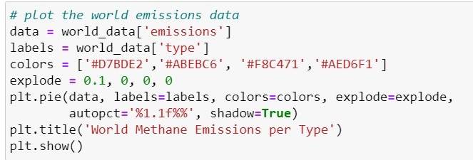
Methane Emission Types Throughout the World
Marks: Area
Channels:
1. Color (hue)
2. Angle
- separated and aligned radially with a uniform height
3. Explode
- the agriculture slice is popped out of the chart showing that this is the largest piece
4. Shadow
- a slight shadow is casted to give the chart a 3D appearance
Figure 1. The methane emission types throughout the world.
Notes:
Pie chart visualization can be used to visualize the most popular methane emission types throughout the World based on the size of the area within the chart. The pie chart also shows percentages.
Types of methane emissions worldwide are Agriculture, Energy, Waste, and other.
Agriculture has the largest area with 39.9% and energy has the second largest area with 37.5%. Agriculture is the top type of methane emission produced worldwide.
Pie chart marks and channels:
- Marks: Area
- represents the type of emissions
- Channels:
1. Color (hue)
- each category is assigned a different color
2. Angle
- separated and aligned radially with a uniform height
3. Explode
- the agriculture slice is popped out of the chart showing that this is the largest piece
4. Shadow
- a slight shadow is casted to give the chart a 3D appearance
(autopct = automatic percent with one decimal place floating point number)

Slide 8
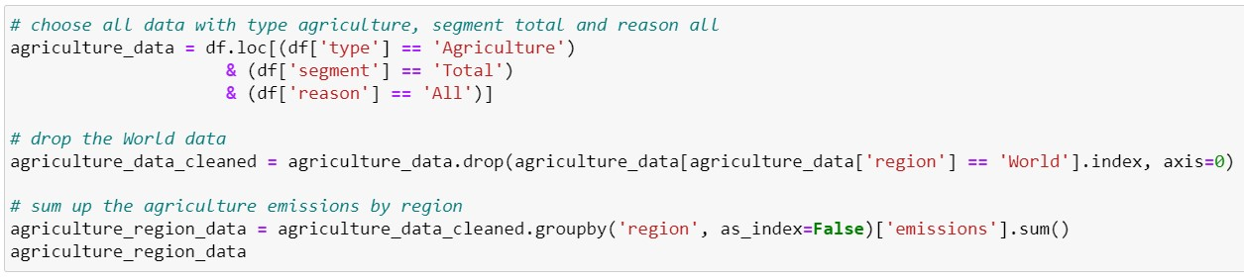
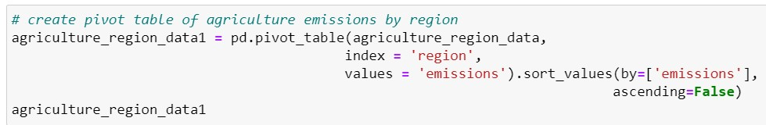
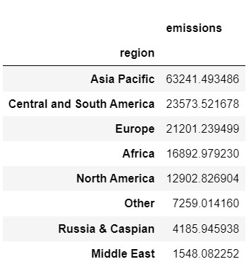
Agriculture Emissions by Region
Years: 2019-2021
Questions to Answer:
What are the total agriculture methane emissions produced by each region?
How do the total agriculture methane emissions of each region compare to one another?
What region produces:
the most agriculture methane emissions?
the least agriculture methane emissions?
Notes:
Agriculture Emissions By Region for 2019-2021
Compare the agriculture methane emissions by region throughout the World.
Selected the Agriculture methane emissions data for each region
Used .loc to select the rows in the type column that includes Agriculture, segment includes Total, and reason includes All
Used the & operator because both conditions must be true
Dropped the rows where World is included because it is not a region
Group by each region and sum up the emissions values for each value in the region column
--- the groupby(region) groups the dataframe by the unique values in the region column
--- emissions specifies we only want to aggregate the emissions column for each group
Created a pivot table by setting the index to region and the values to the total emissions for each region. Sorted them in descending order

Slide 9
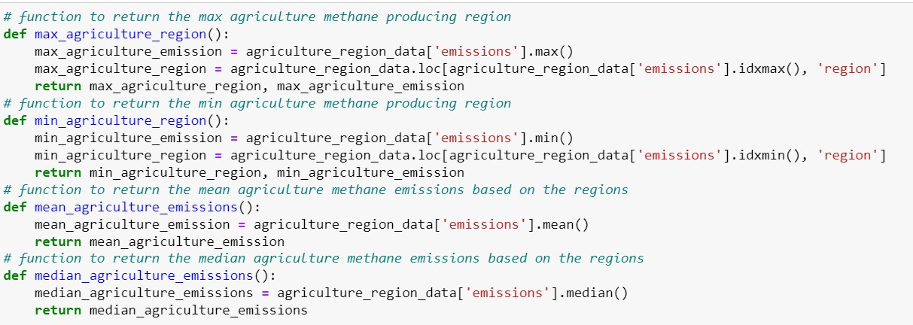
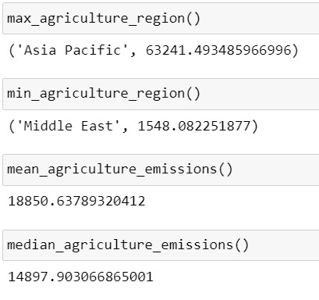
Agriculture Emissions by Region
Years: 2019-2021
Notes:
Functions to return the max and min agriculture producing regions
MAX:
Max agriculture emissions finds the max emission value using the .max() function
Max agriculture region finds the index (row) of the region corresponding to the max emissions using the .idxmax() function
MIN:
Min agriculture emissions finds the min emission value using the .min() function
Min agriculture region finds the index (row) of the region corresponding to the min emissions using the .idxmin() function
MEAN/MEDIAN:
- Selects the emissions column in the dataframe and calculates (mean/median)

Slide 10
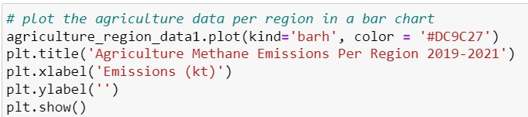
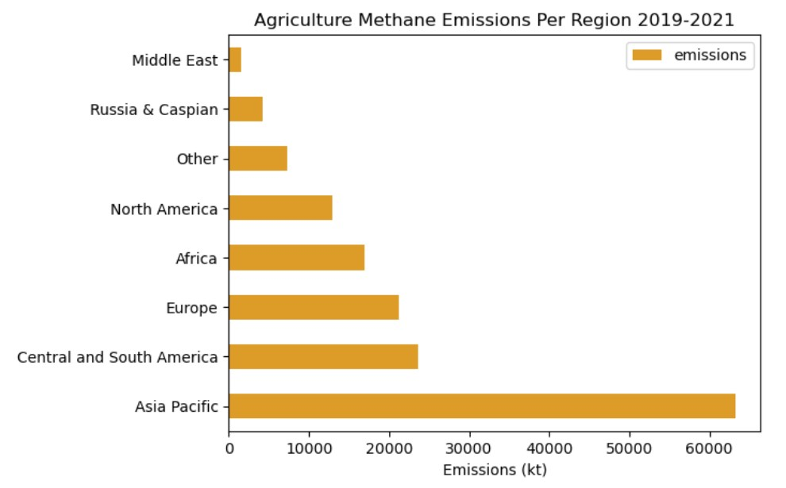
Agriculture Emissions by Region
Years: 2019-2021
Marks: Line
Channels:
1. Length
2. Position on common scale (vertical)
3. Spatial regions
- one per mark
- aligned horizontally, separated vertically
Top 3 Methane Agriculture Emitter Regions
Asia Pacific
Central and South America
Europe
Figure 2. The agriculture methane emissions by region throughout the world.
Notes:
Bar chart visualizations can be used to visualize and compare the top producers of methane emissions by type agriculture based on the length of the bar.
Horizontal bar chart by setting kind to ‘barh’
kt = kilotons
The Asia Pacific is the largest producer of agriculture methane emissions throughout the World.
The second largest producer is Central and South America. Close behind this region is Europe.
The Middle East produces the least agriculture methane emissions.
It is shown that the Asia Pacific has a great advantage at producing methane emissions through agriculture over other regions.
Asia Pacific has a very large population and livestock population.
More than half of the land in Asia is used for agriculture with rice being the most important crop (90% of the worlds production and consumption occurs throughout this region).
Bar Chart Marks & Channels:
Marks: line
Channels:
Length
expresses quantitative values
Position on common scale
vertical
Spatial regions
one per mark
aligned horizontally
separated vertically
ordered by quantitative attribute

Slide 11
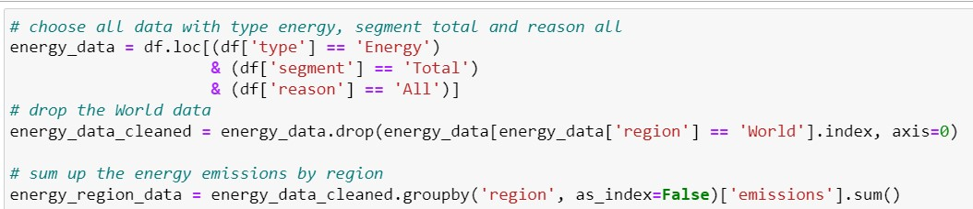
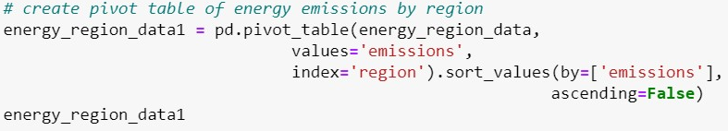
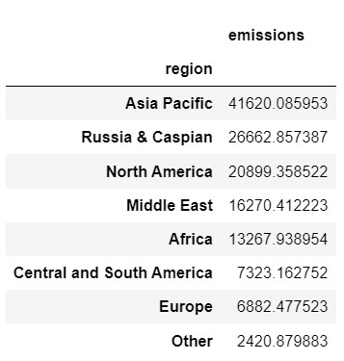
Energy Emissions by Region
Type: Energy
Year: 2022
Questions to Answer:
What are the total energy methane emissions produced by each region?
How do the total energy methane emissions of each region compare to one another?
What region produces the most energy methane emissions?
Notes:
Energy Emissions By Region in 2022
Compare the energy methane emissions by region throughout the World.
Selected the Energy methane emissions data for each region
Used .loc to select the rows in the type column that includes Energy, segment includes Total, and reason includes All
Used the & operator because both conditions must be true
Dropped the rows where World is included because it is not a region
Group by each region and sum up the emissions values for each value in the region column
--- the groupby(region) groups the dataframe by the unique values in the region column
--- emissions specifies we only want to aggregate the emissions column for each group
Created a pivot table by setting the index to region and the values to the total emissions for each region. Sorted them in descending order

Slide 12
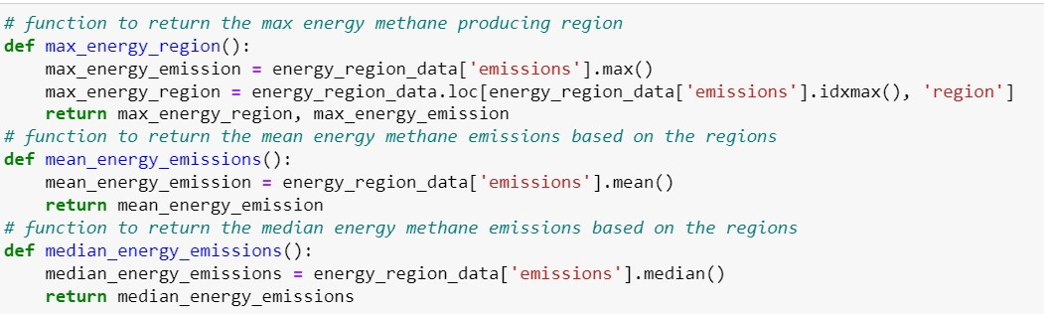
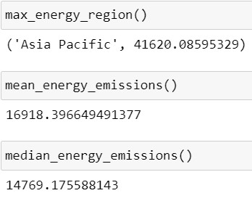
Energy Emissions by Region
Type: Energy
Year: 2022
Notes:
Functions to return the max energy producing regions
MAX:
Max energy emissions finds the max emission value using the .max() function
Max energy region finds the index (row) of the region corresponding to the max emissions using the .idxmax() function
MEAN/MEDIAN:
- Selects the emissions column in the dataframe and calculates (mean/median)

Slide 13
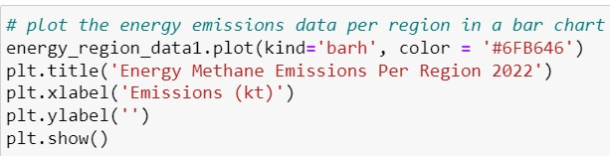
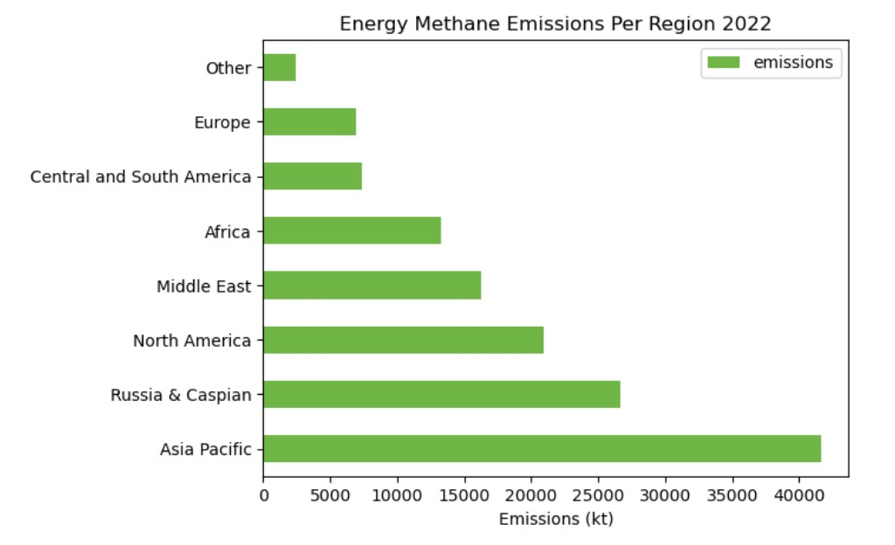
Energy Emissions by Region
Type: Energy
Year: 2022
Marks: Line
Channels:
1. Length
2. Position on common scale (vertical)
3. Spatial regions
- one per mark
- aligned horizontally, separated vertically
Top 3 Methane Energy Emitter Regions
Asia Pacific
Russia and Caspian
North America
Figure 3. The energy methane emissions by region throughout the world.
Notes:
Bar chart visualizations can be used to visualize and compare the top producers of methane emissions by type energy based on the length of the bar.
Horizontal bar chart by setting kind to ‘barh’
kt = kilotons
The Asia Pacific is the largest producer of energy methane emissions throughout the World.
The second and third largest producers of energy methane emissions are Russia and Caspian and North America, respectively.
It is shown that the Asia Pacific has a greater advantage of producing energy methane emissions over other regions.
The Asia Pacific has a fast growing economy causing a higher demand for energy which means that more energy methane emissions will be emitted, such as fossil fuels (coal, oil, natural gas).
According to the agriculture and energy bar charts, the Asia Pacific produces the greatest methane by both agriculture and energy emissions.
Bar Chart Marks & Channels:
Marks: line
Channels:
Length
expresses quantitative values
Position on common scale
vertical
Spatial regions
one per mark
aligned horizontally
separated vertically
ordered by quantitative attribute

Slide 14
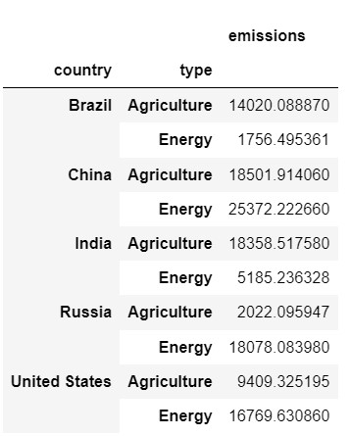
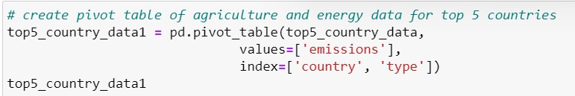
Agriculture & Energy Emissions Produced by the Top 5 Methane Emitting Countries
Questions to Answer:
What are the total agriculture and energy methane emissions produced by each of the top 5 methane emitting countries?
How do the total agriculture and energy methane emissions of each country compare to one another?
Which of the top 5 methane emitting countries produces:
the greatest agriculture methane emissions?
the greatest energy methane emissions?
the least agriculture methane emissions?
the least energy methane emissions?
Notes:
Total Agriculture and Energy Methane Emissions for the Top 5 Methane Emitting Countries
Compare the agriculture methane emissions and energy methane emissions for the top 5 methane emitting countries. The top 5 countries include China, Russia, the United States, India, and Brazil.
Selected the Agriculture & Energy methane emissions data for each of the top 5 countries
Used .loc to select the following:
Used .isin to create a Boolean series that returns True if it matches one of the top 5 countries and these values are selected
The segment is set to total
The type is set to Agriculture and Energy only
Used the & operator because both conditions must be true
Sorted the values by country
Created a pivot table by setting the index to country and type and the values to the emissions for each

Slide 15
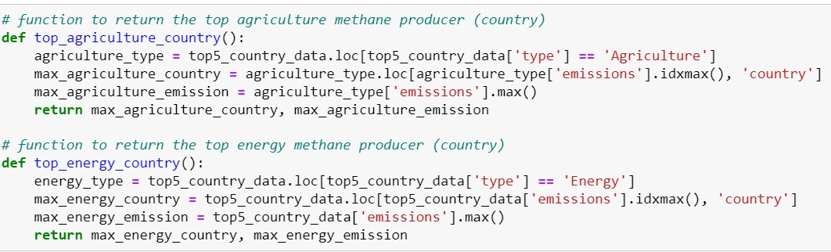
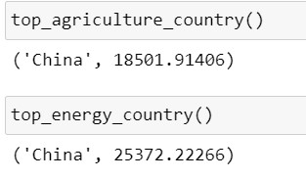
Agriculture & Energy Emissions Produced by the Top 5 Methane Emitting Countries
Notes:
Functions to return the max agriculture and energy producing countries among the top 5 methane emitting countries
MAX AGRICULTURE:
Agriculture type selects the rows with type agriculture
Max agriculture country finds the index (row) of the region corresponding to the max emissions for agriculture using the .idxmax() function
Max agriculture emissions finds the max emission value using the .max() function
MAX ENERGY:
Energy type selects the rows with type energy
Max energy country finds the index (row) of the region corresponding to the max emissions for energy using the .idxmax() function
Max energy emissions finds the max emission value using the .max() function

Slide 16
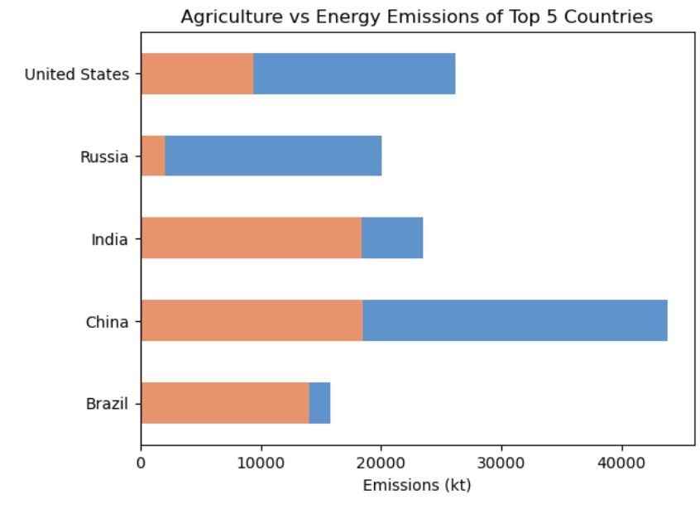
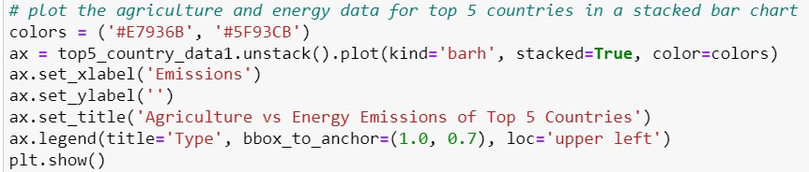
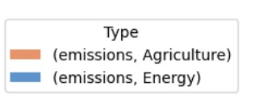
Agriculture & Energy Emissions Produced by the Top 5 Methane Emitting Countries
Marks: Horizontal stack of line marks
Channels:
1. Length
2. Position on common scale (vertical)
3. Color (hue)
4. Spatial regions
- two per mark
- aligned horizontally, separated vertically
Figure 4. The agriculture and energy methane emissions for the top 5 methane emitting countries throughout the world.
Notes:
Stacked bar chart visualizations can be to determine the part-to-whole relationship. It can be used to visualize the top producers of agriculture and energy methane emissions based on the length of the two bars.
For Agriculture Methane Emissions
China and India produce the highest methane emissions through agriculture. The Asia Pacific is the greatest producer of agriculture methane emissions and China and India are both countries within this region. They are large agricultural producers with China being the worlds largest producer of rice. Both countries have a large livestock population and use organic fertilizers which can produce methane emissions through decomposition. Along with this, lack of regulation.
The least effective producer of agriculture methane emissions is Russia. Compared to China and India, Russia does not have much agriculture. This can be due to their colder climate, meaning that less methane producing microbes (microorganisms that produce methane found in oxygen free environments) can reproduce and survive. Russia has worked on improving their ways of agriculture by using more efficient fertilizers and reducing their livestock.
According to the data, the results align for top regions and top 5 countries:
Top 3 regions:
Asia Pacific
Central & South America
Europe
Top 3 countries:
China
India
Brazil
China and India are both part of the Asia Pacific region. Brazil is part of the Central and South America region.
For Energy Methane Emissions
China produces the highest methane emissions through energy. The Asia Pacific is the greatest producer of energy methane emissions and China is a country within this region. China relies on coal for electricity, oil and gas production. Coal mining is one of the most significant sources of energy methane emissions from China.
The least effective producer of energy methane emissions is Brazil. Brazil does not rely heavily on fossil fuels (they use renewable energy such as hydropower, wind, solar). Brazil also does not have a significant amount of coal mining due to limability.
According to the data, the results align for top regions and top 5 countries:
Top 3 regions:
Asia Pacific
Russia and Caspian
North America
Top 3 countries:
China
Russia
United States
China is a part of the Asia Pacific. Russia is a part of Russia and Caspian. United States is part of North America.
Unstack method pivots the dataframe so that the values for each emission type is separate columns and each row is a country.
Stacked = True sets the emissions for each country to stack on top of each other. The ax.legend() method is used to add a legend to the chart. The bbox_to_anchor argument specifies the position of the legend relative to the chart, and the loc argument specifies the location of the legend within the bounding box.
Stacked Bar Chart Marks & Channel
Mark: Horizontal stack of line marks
Channels
Length
expresses quantitative values
Position on common scale
vertical
Color (hue)
different colors based on emisson type (agriculture/energy)
Spatial regions
two per mark
aligned horizontally, separated vertically

Slide 17
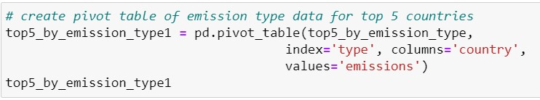
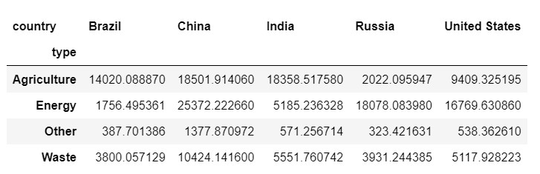
Total Emissions for Top 5 Countries per Emission Type
Questions to Answer:
Which countries are the greatest producers for each type of methane emissions?
Which country has the greatest difference between agriculture and energy methane emissions?
Which type of methane emission is most produced across the top 5 methane emitting countries?
Which type of methane emissions has the greatest difference amongst the top 5 methane emitting countries?
Notes:
Total Methane Emissions By Type for the Top 5 Methane Emitting Countries
Compare the different types of methane emissions for the top 5 methane emitting countries.
Selected the Total Emissions per type for the top 5 countries
Used .loc to select the following:
Used .isin to create a Boolean series that returns True if it matches one of the top 5 countries and these values are selected
The segment is set to total
Used the & operator because both conditions must be true
Sorted the values by country
Created a pivot table by setting the index to type, the columns by country, and the values by emissions

Slide 18
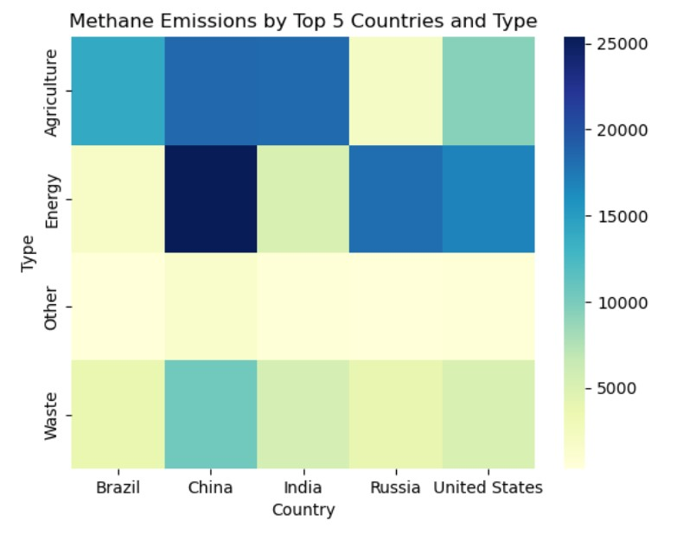
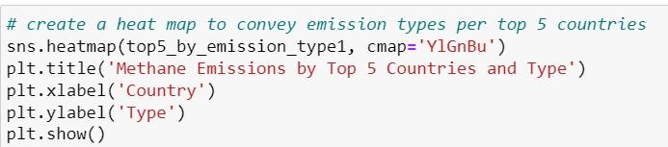
Total emissions for top 5 countries per emission type
Marks: Points
Channels:
1. Color (hue) by quantitative attribute (emissions)
Figure 5. Heat map displaying the total methane emissions for the top 5 methane emitting countries throughout the world based on type of methane emission.
Notes:
Heat map visualizations can be used to visualize the top producers for each type of methane emissions based on the saturation of the corresponding box in the heat map. Heat maps can visualize the correlation between the types of methane emissions and countries.
According to the map, China is the number one producer of energy, waste, and other methane emissions.
Russia has the greatest difference in emissions between energy and agriculture.
Agriculture and energy have a majority of darker colors compared to that of waste and other. Energy shows the greatest difference across the countries.
For agriculture, as we already know China and India are the top two producers of agriculture methane emissions. Their total emissions for agriculture are almost the same which can be shown in the heat map because their shades are almost identical.
It is difficult to differentiate between the top agriculture producer, but it is clear who the top energy producer is (China).
Cmap is short for colormap: set to yellow-green-blue
Heat Map Marks & Channels:
Marks: Points
Channels:
Color (hue) by quantitative attribute (emissions)

Slide 19

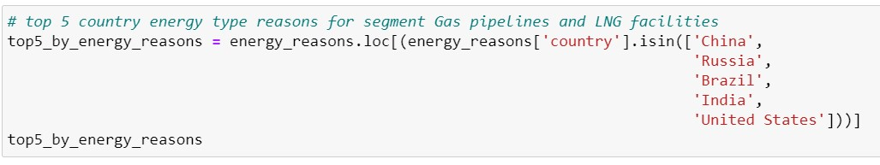
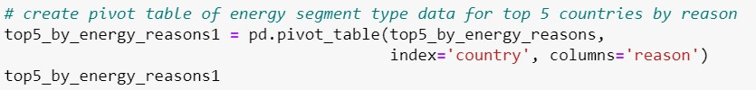
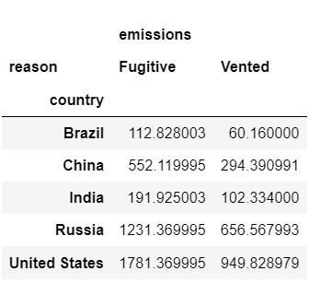
Gas pipelines and LNG facilities segment for type energy for top 5 countries
Gas pipelines and Liquified Natural Gas (LNG) facilities have two reasons:
Fugitive vs Vented.
Fugitive methane emissions:
- occur from leakages
- are unintended
- can occur from faulty seals/leaks, or malfunctions
Vented methane emissions:
- occur from intentional releases
- examples: safety reasons, due to the design of the facility or equipment (e.g. pneumatic controllers) or operational requirements (e.g. venting a pipeline for inspection and maintenance)
Questions to Answer:
Which country is the greatest producer of:
fugitive methane emissions?
vented methane emissions?
Which country is the produces the least:
fugitive methane emissions?
vented methane emissions?
Based on the top 5 countries, which emission is produced more, fugitive or vented?
Notes:
Gas Pipelines and LNG Facilities Segment for Energy Methane Emissions for the Top 5 Countries
Compare the Gas pipelines and Liquified Natural Gas (LNG) facilities segment for the energy methane emissions for the top 5 methane emitting countries.
Gas pipelines and LNG facilities have two reasons: Fugitive vs Vented.
Fugitive methane emissions:
occur from leakages
are unintended
can occur from faulty seals/leaks, or malfunctions
Vented methane emissions:
occur from intentional releases
examples: safety reasons, due to the design of the facility or equipment (e.g. pneumatic controllers) or operational requirements (e.g. venting a pipeline for inspection and maintenance)
Selected the Gas pipelines and LNG facilities for type Energy for each of the top 5 countries
Used .loc to select the rows with type energy and segment set as Gas pipelines and LNG facilities
Used the & operator because both conditions must be true
Select all the countries using .isin()
Created a pivot table by setting the index to country and columns to reason (fugitive/vented)

Slide 20
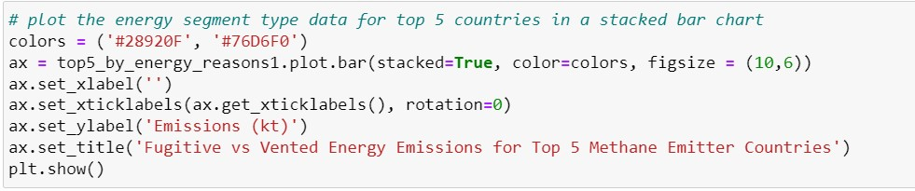
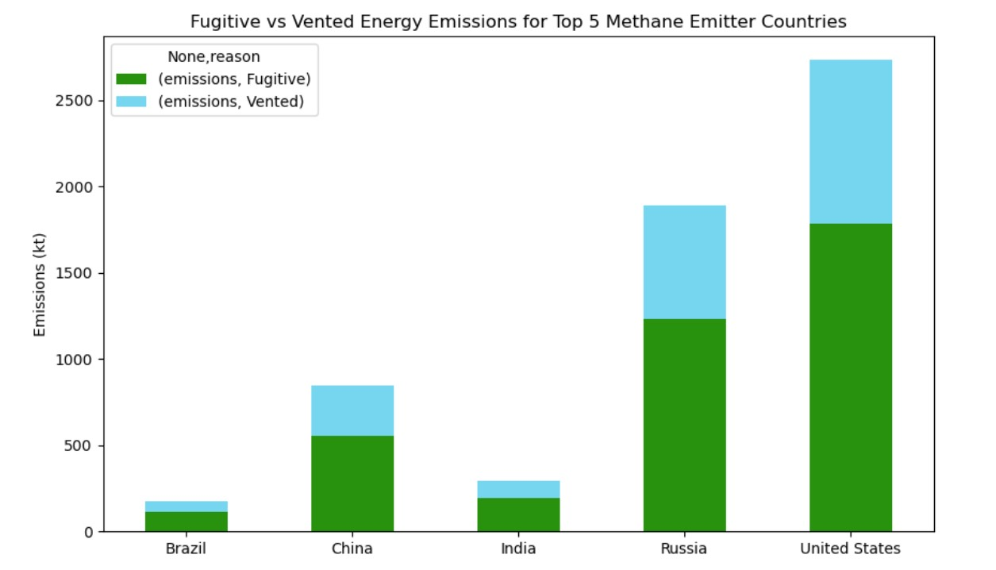
Gas pipelines and LNG facilities segment for type energy for top 5 countries
Marks: Vertical stack of line marks
Channels:
1. Length
2. Position on common scale (horizontal)
3. Color (hue)
4. Spatial regions
- two per mark
- aligned horizontally, separated vertically
Figure 6. The energy segment Gas pipelines and LNG facilities reasons, fugitive and vented, for the top 5 methane emitting countries throughout the world.
Notes:
Stacked bar chart visualizations can be to determine the part-to-whole relationship. It can be used to compare the two types of reasons for this segment based on the length of the two bars. This stacked bar chart visualization can help understand how the type of energy is emitted into the atmosphere by gas pipelines and LNG facilities.
Fugitive emissions are much higher compared to vented.
The United States is the greatest producer for both fugitive and vented energy methane emissions. The United States has a high oil and gas production (especially natural gas for electricity), the aging natural gas infrastructure, and coal mining.
Brazil produces the least amount of fugitive and vented energy methane emissions. Brazil uses renewable resources to produce electricity as stated before. Brazil has regulations and programs that reduce these type of emissions into our atmosphere.
Stacked Bar Chart Marks & Channel
Mark: Vertical stack of line marks
Channels:
Length
expresses quantitative values
Position on common scale (horizontal)
Color (hue)
Spatial regions
two per mark
aligned horizontally, separated vertically

Slide 21
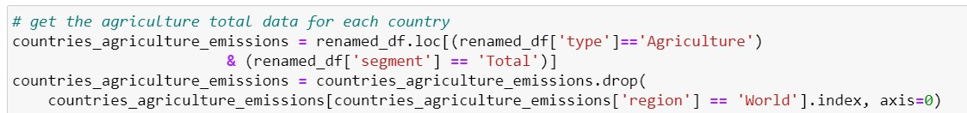
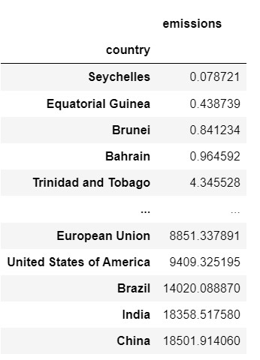
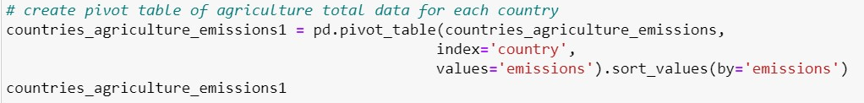
Agriculture Emissions Produced by All Countries
Questions to Answer:
Where in the world is the most agriculture methane emissions produced?
What country produces the most agriculture methane emissions throughout the World?
Notes:
Agriculture Methane Emissions Per Country
Compare the total agriculture methane emissions for each country throughout the World.
Selected the Agriculture Emissions for all countries
Renamed the United States to United States of America because in geopandas, this is what the name of the United States is labeled as. Without doing so, the data for the United States would not be included in the graph and the results would be inaccurate.
Used .loc to select the rows in the type column that includes Agriculture and segment includes Total
Used the & operator because both conditions must be true
Drop the World data
Created a pivot table by setting the index to country and the to emissions
Sort by emissions

Slide 22
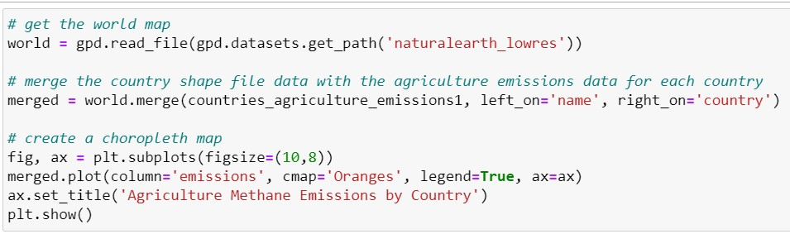
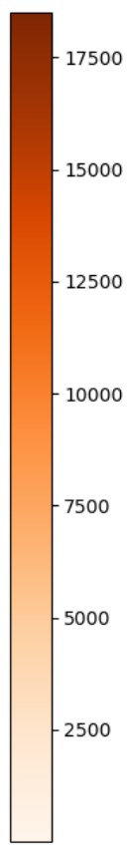
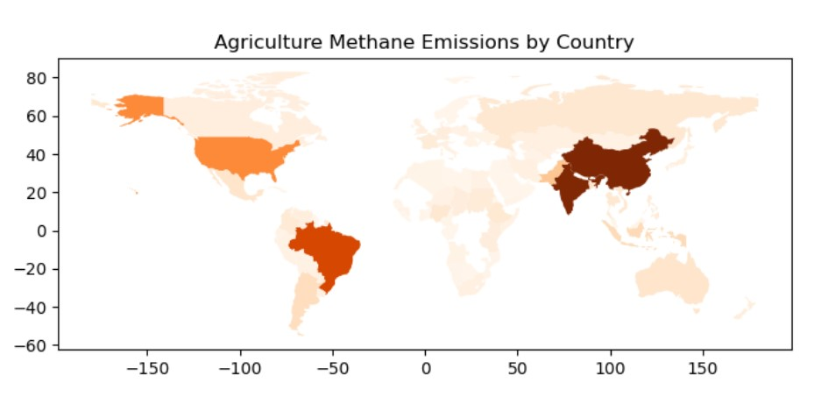
Agriculture Emissions Produced by All Countries
Marks: Area
Channels:
1. Color (hue)
Figure 7. The agriculture methane emissions by country throughout the world.
Notes:
Choropleth map visualizations can be used to visualize the top producers of agriculture methane emissions based on the saturation of the area on the world map.
The Asia Pacific, specifically China and India have darkest shade of orange meaning they are the greatest agriculture methane producers in the world.
Choropleth Map Marks & Channels:
Marks: Area
Channels:
Color (hue)

Slide 23
Summary
Methane is an important greenhouse gas found within our atmosphere that traps heat.
Types of Methane Emissions:
Agriculture
Energy
Waste
Other
Top Agriculture Emitting Regions:
Asia Pacific
Central and South America
Europe
Top Energy Emitting Regions:
Asia Pacific
Russia and Caspian
North America
Top Agriculture Emitting Countries:
China
India
Brazil
Top Energy Emitting Countries:
China
Russia
United States
Two Highest Methane Emissions Produced Worldwide:
Agriculture (mean: 18,850.64 kt)
Energy (mean: 16,918.40 kt)

Slide 24
Citations
1. IEA (2023), Methane Tracker, IEA, Paris https://www.iea.org/data-and-statistics/data-tools/methane-tracker
2. “Greenhouse Gases.” EPA, Environmental Protection Agency, 19 Mar. 2020, https://www.epa.gov/report-environment/greenhouse-gases.
3. “Center for Science Education.” Methane | Center for Science Education, 2012, https://scied.ucar.edu/learning-zone/how-climate-works/methane#:~:text=Methane%20is%20gas%20that%20is,is%20a%20powerful%20greenhouse%20gas.

Slide 25
QUESTIONS?

